Slide 1
What is advocacy?
How can it help us achieve our goal?

Slide 2
What is advocacy?
The act of supporting a cause, idea or policy and convincing the right people of its importance and the need to act on it
An essential tool for changing practices and polices
Advocates use their voices to share ideas, persuade others and create change

Slide 3
Who is an advocate?
We can all be advocates
As researchers, we can use scientific evidence to influence policy by getting it into the hands of decision makers
Decision makers need data to inform health policy
Disease burden
Intervention impact
Cost effectiveness
They also need to understand it and how to act on it …that’s where you come in

Slide 4
Scientists as advocates
Fulfilling a critical role
No one knows this issue better, you are the experts
The most compelling messengers are passionate and invested in an issue
Your job is to be credible and unbiased -- that’s just what decision makers are looking for

Slide 5
How to be an effective advocate
Determine…
What is the issue or the problem that needs to be solved?
Who are the most important people who need to be reached?
What do they need to hear to make them care and compel them to act?
What is the best way to reach them?
What do you need them to do?
Who are the best messengers?

Slide 6
How to be an effective advocate
Set an overarching goal: what you are trying to achieve

Slide 7
How to be an effective advocate
Define your target audience(s): who are the most important people for you to reach and persuade in order to achieve your goal?
Identify who has the power to implement the change you seek and assess their position
What do they need? More information? Funding? Is your issue a political priority? What are the barriers?
Example: MoH/MoF officials

Slide 8
How to be an effective advocate
Determine the strategy: the plan you will use to achieve your goal and the tactics you will use
Tactics could include policy briefings, one-on-one meetings, media interviews
Example: gather the most compelling evidence, have credible sources share it with MoH/MoF officials in advance of vaccine-related decisions

Slide 9
How to be an effective advocate
Craft key message(s): the most important thing your audience needs to know to compel them to act the way you want them to act
Consider your audience’s point of view; put yourself in their shoes
Create a few simple, compelling messages
Show the benefits of action
Identify specific actions to be taken
Address the problem, solution and call to action

Slide 10
How to be an effective advocate
Key messages example:
Problem
Solution
Call to Action
Rotavirus kills nearly 500,000 children worldwide each year and is responsible for millions of hospitalizations and clinic visits
Rotavirus vaccines provide the best protection against rotavirus; every child should be vaccinated
Introduce rotavirus vaccines into NIPs now

Slide 11
How to be an effective advocate Determine the best messengers and channels through which to reach your target audience
Who are the most compelling voices? Scientists? Parents? Doctors?
What is the best way to reach them?
The more contacts you can make, the better; message repetition matters

Slide 12
How to be an effective advocate
Once you have your plan…act!
Identify and engage champions with local and regional credibility
Build consensus prior to engaging in advocacy and use the same messages
Ensure the information disseminated is accurate and unambiguous
Partner with others to amplify your efforts; the more voices you have, the louder you will be

Slide 13
How to be an effective advocate
Evaluate and course-correct as you go
Are you gaining partners? Are others joining your efforts?
Are your meetings/events well attended?
Are your materials read?
Are policymakers committing to support your idea?

Slide 14
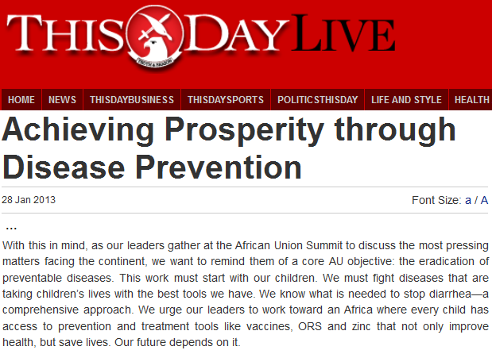
Advocacy examples
Simple steps you can take to be an advocate:
Op-ed placed during African Union Summit
Brief policy makers on your research
Share your publication with a journalist and offer to do an interview
Write a letter to the editor or submit an op-ed for publication in a newspaper

Slide 15
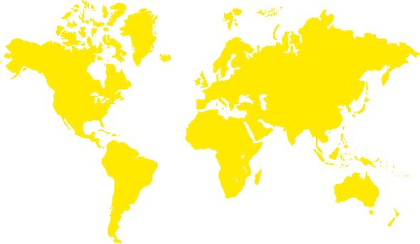
Advocacy examples
The ROTA Council is working to accelerate the introduction of rotavirus vaccines through the use of evidence and strategic communications
Its mission is to save lives and improve health by promoting the use of rotavirus vaccines as part of a comprehensive approach to diarrhea
What makes it unique is its focus on providing evidence for decision making through credible scientific authorities

Slide 16
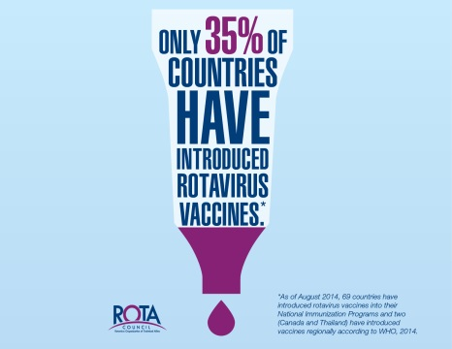
Advocacy resources: rotacouncil.org/toolkit
The ROTA Council works to accelerate the introduction of rotavirus vaccines through the use of evidence and strategic communications
Provides evidence for decision making through credible scientific authorities
Resources: ROTACouncil.org & Advocacy Toolkit Includes talking points, fact sheets, data, presentations: rotacouncil.org/toolkit

Slide 17
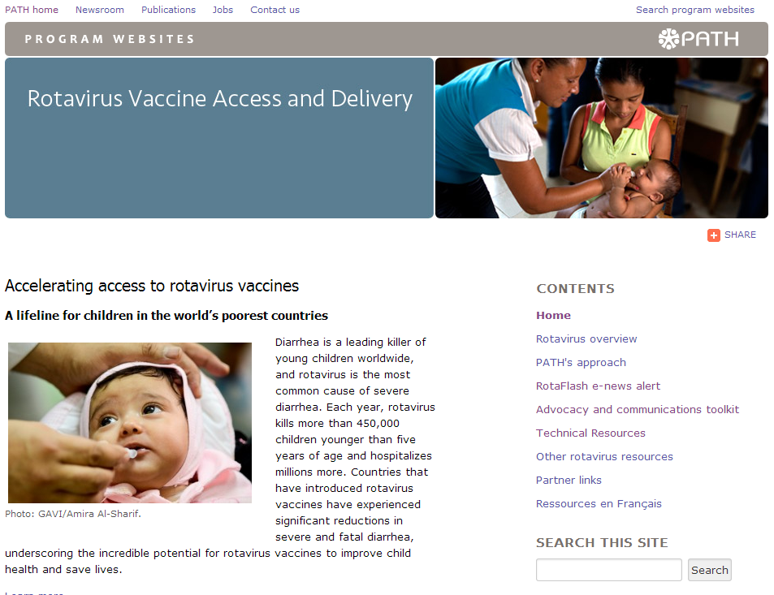
Advocacy resources: rotavirus.org
Toolkit
Key messages
Fact sheets
FAQ
Introduction maps
Impact tables
Ressources en Français
Messages clés
Fiches techniques
Questions fréquemment posées
Cartographie de l’introduction
Tableaux de l’impact
Technical Resources
Articles/Supplements
Messages for NIP/EPI Managers

