Slide 1
ROTAVIRUS
COMMON, SEVERE, DEVASTATING, PREVENTABLE
THE LATEST EVIDENCE & WHAT’S NEEDED TO STOP ILLNESSES AND DEATHS

Slide 2
ROTA COUNCIL RECOMMENDATIONS
33

Slide 3
Despite the WHO recommendation that rotavirus vaccines be introduced into every country’s national immunization program, about 94 million children throughout the world still do not have access to this critical intervention. The ROTA Council strongly endorses the recommendation by WHO. To accelerate the introduction of life-saving, health-improving rotavirus vaccines, the ROTA Council recommends key stakeholders – in countries where these vaccines have not yet been introduced – undertake actions in the following areas…

Slide 4
Key Stakeholders
Global health organizations: WHO, UNICEF, Gavi
Funding agencies
Manufacturers
Researchers
National & local governments in LMICs & HICs
Gavi-eligible (low-income) country decision makers
Non-governmental organizations
Frontline health workers
Educational authorities & academics
Media & advocacy groups

Slide 5
To encourage rotavirus vaccine introduction in Gavi-eligible (low-income) countries:
1) Gavi-eligible countries that have not yet introduced rotavirus vaccines should strongly consider applying to Gavi for new vaccine support as soon as possible
2) To optimize vaccine rollout & maximize number of eligible infants immunized, WHO, UNICEF, Gavi, and other partners should continue to support countries planning to introduce the vaccine (especially cold chain, available supply, and sustainable financing)
3) If rotavirus vaccine of choice is not available, countries should strongly consider introducing any prequalified rotavirus vaccine available in the short-term and work with Gavi for longer-term options.
4) Low- and lower-middle-income countries that have introduced should share lessons with countries that have not yet introduced through focused regional meetings.
5) Countries planning to introduce rotavirus vaccines should establish a strong surveillance system.
6) Countries that have introduced OR plan to introduce should collect high-quality data to evaluate vaccine impact (esp. on districts with high mortality rates).
7) Funding agencies should continue to support evaluation of rotavirus vaccine programs (operation, safety, impact).

Slide 6
To encourage rotavirus vaccine introduction in non-Gavi-eligible (lower-middle-, middle- and high-income) countries:
1) National & local governments enact legislation that addresses issues of the rights of populations to receive recommended vaccines & provisions to ensure supply of quality, affordable vaccines.
2) Governments & funding agencies should continue to support research & development of new, low-cost rotavirus vaccines using public, social business, & public-private models.
3) Global health agencies & NGOs influential in vaccine programs expedite initiatives to ensure prices paid for rotavirus vaccines reflect true manufacturing costs, provide reasonable returns on manufacturers’ investments, and take into account a country’s ability to pay. All countries should report the price of their vaccine to WHO’s V3P Project.
4) To ensure integration with existing interventions by GAPPD, national governments should provide training courses to update frontline health workers; and, data should be collected by educational authorities & academia to determine the information being incorporated into health worker curricula.
5) National governments, funding agencies, and global health entities should support media & advocacy groups to ensure benefits of rotavirus & other vaccines are conveyed to the public.
6) WHO, UNIFEC, and NGOs should collect data to better understand reasons why a number of high-income countries have not yet included rotavirus vaccines in their NIP.

Slide 7
To influence the research agenda & gain better understanding of impact, effectiveness and safety of rotavirus vaccines – particularly in low-income countries of Africa and Asia – researchers should:
1) Quantify changes in morbidity & mortality from severe diarrheal disease in countries using rotavirus vaccine
2) Examine effect of vaccination on epidemiology of rotavirus
3) Assess evidence of indirect benefits among unvaccinated children
4) Perform long-term monitoring to assess possible changes in ecology of circulating strains after vaccine implementation
5) Assess effectiveness of vaccination beyond one year of age & against circulating strains
6) Examine vaccine safety with respect to intussusception in targeted settings & assess identified risks in the context of vaccine benefits

Slide 8
To influence the research agenda & gain better understanding of reasons for moderate efficacy of live, oral rotavirus vaccines in low-income countries and to identify strategies to improve vaccine performance, researchers should:
1) Assess possible interference of oral polio vaccine, breastfeeding, and gut microbiome and/or intestinal enteropathy on vaccine effectiveness
2) Investigate regional differences in vaccine impact related to genetic differences and specific immunological characteristics of circulating strains
3) Examine effect of different vaccine schedules on vaccine performance

Slide 9
To influence the research agenda & gain better understanding of different options for formulations aimed at increasing vaccine uptake and/or addressing diarrheal disease simultaneously, researchers and manufacturers should:
1) Pursue development of non-live oral vaccines and birth dose of live oral vaccine that may overcome come interference observed in low-income countries
2) Explore the mechanism of immunologic protection for rotavirus infection/disease to help identify correlates of protection to facilitate vaccine testing
3) Develop formulations and packaging that requires less cold chain space or can even be outside the cold chain
4) Explore impact of live oral rotavirus vaccines on non-specific effects of vaccination

Slide 10
To encourage the development of new rotavirus vaccines, national governments, funding agencies, international health organizations, manufacturers and other stakeholders should:
1) Facilitate development of new live oral vaccines to address barriers to global supply for Gavi & low- and middle-income countries; implementation challenges & cultural sensitivity; and that are also safe, efficacious and available at low cost. This research agenda should address: implications of lack of correlate of protection, formulations to enhance programmatic suitability & vaccine stability, and improvements to manufacturing process efficiency.
2) Facilitate development of alternative rotavirus vaccines. This research agenda should address: clinical development, vaccine development and mechanism of action of injectable, non-replicating vaccines against rotavirus disease.
3) Pursue options for immunization schedules aimed at improving protection, including: neonatal schedules, booster dose or even prime-boost strategies.
4) Explore combination vaccine & non-vaccine strategies aimed at reducing diarrheal disease and/or improving vaccine uptake.
5) Explore options for combination viral & bacterial enteric vaccines to provide protection against diarrhea caused by a range of potential pathogens.

Slide 11
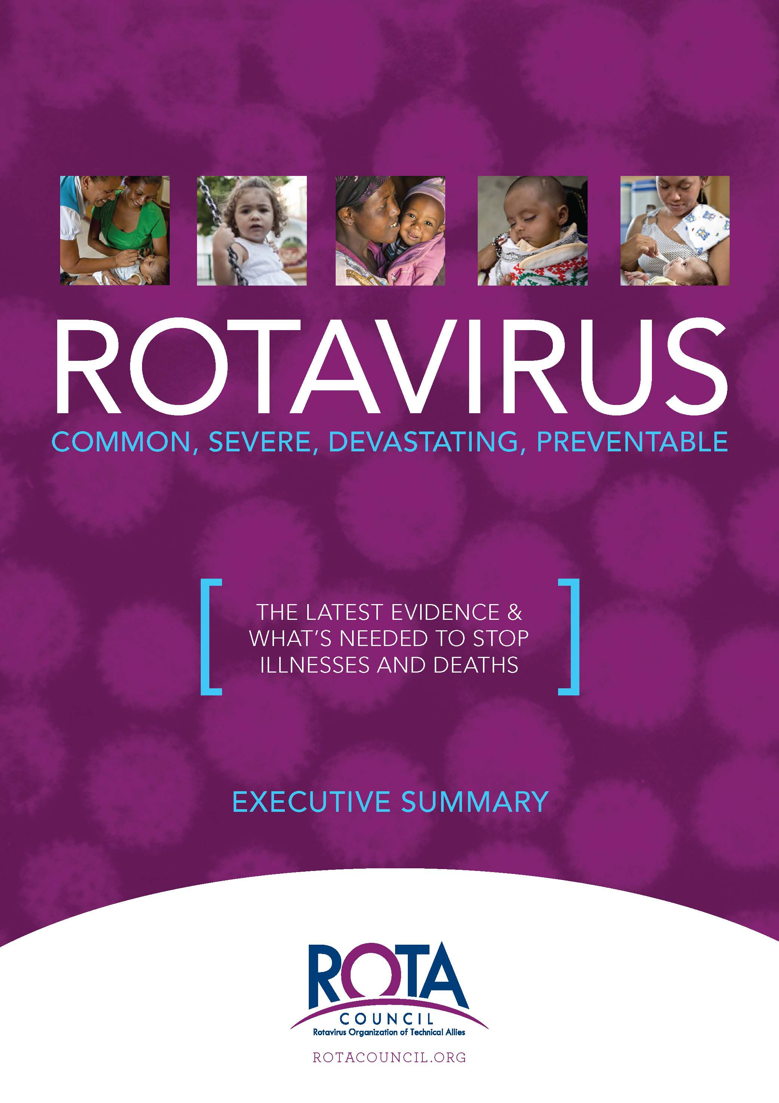
White Paper Resources
Full paper
http://rotacouncil.org/resources/White-paper-FINAL-v2.pdf
Executive summary
http://rotacouncil.org/resources/White_paper_ExecSummary_FINAL.pdf
ROTA Council resources
http://rotacouncil.org/toolkit/

